Slide 1
Lecture 22
Critical-Section Problem –
Software Solutions
National University of
Computer & Emerging Sciences

Slide 2
The Critical-Section Problem
Each process has a code segment, called Critical Section (CS), in which the shared data is accessed.
Problem – ensure that when one process is executing in its CS, no other process
is allowed to execute in its CS.

Slide 3

Solution to Critical-Section Problem
There are 3 requirements that must stand for a correct solution:
  Mutual Exclusion
  Progress
  Bounded Waiting

Slide 4
Solution to CS Problem – Mutual Exclusion
Mutual Exclusion – If process P_{i} is executing in its critical section, then no other processes can be executing in their critical sections.
Implications:
  Critical sections better be focused and short.
  Better not get into an infinite loop in there.

Slide 5
Solution to CS Problem – Progress
Progress – If no process is executing in its critical section and there exist some processes that wish to enter their critical section, then the selection of the process that will enter the critical section next cannot be postponed indefinitely:
  If only one process wants to enter, it should be able to.
  If two or more want to enter, one of them should succeed.

Slide 6
Solution to CS Problem – Bounded Waiting
Bounded Waiting –
There is an upper bound on the number of times a process enters the critical section, while another is waiting.
a process has made a request to enter its critical section
before that request is granted
A bound must exist on the number of times that other processes are allowed to enter their critical sections after and.
  Assume that each process executes at a nonzero speed.
  No assumption concerning relative speed of the n processes.

Slide 7
Lock Variables: Software Solution
Before entering a critical section a process should know if any other is already in the critical section or not
Consider having a FLAG (also called lock)
FLAG = FALSE
  A process is in the critical section
FLAG = TRUE
  No process is in the critical section
// wait while someone else is in the
// critical region
while (FLAG == FALSE)
; // do nothing
// 2. FLAG = FALSE; stop others from entering critical region
3. critical_section();
// after critical section let others enter
//the critical region
4. FLAG = TRUE;
5. noncritical_section();

Slide 8
Lock Variables
FLAG = TRUE
FLAG = FALSE
FLAG = TRUE
FLAG = FALSE
FLAG = FALSE
Process 1
1.while (FLAG == FALSE);
2.FLAG = FALSE;
Process 2
1.while (FLAG == FALSE);
1.while (FLAG == FALSE);
2.
2.FLAG = FALSE;
3.critical_section();
3.critical_section();
4.FLAG = TRUE;
5.noncritical_section();
Timeout
No two processes may be simultaneously inside their critical sections
Process 2 Busy Waits
Process 2 ‘s Program counter is at Line 2
Process 1 forgot that it was Process 2’s turn

Slide 9
Solution: Strict Alternation
We need to remember “Who’s turn it is?”
If its Process 1’s turn then Process 2 should wait
If its Process 2’s turn then Process 1 should wait
Process 1
while(TRUE)
{
// wait for turn
while (turn != 1)
;
critical_section();
turn = 2;
noncritical_section();
}
Process 2
while(TRUE)
{
// wait for turn
while (turn != 2)
;
critical_section();
turn = 1;
noncritical_section();
}

Slide 10
Strict Alternation
Turn = 1
Turn = 2
Turn = 1
Process 1
While(1)
1.while (Turn != 1);
Process 2
While(1)
1.while (Turn != 2);
1.while (Turn != 2);
2.
2.critical_section();
2.critical_section();
3.Turn = 2;
4.noncritical_section();
3.Turn = 1;
4.noncritical_section();
Timeout
Only one Process is in the Critical Section at a time
Process 2 Busy Waits
Process 2 ‘s Program counter is at Line 2
Process 1 Busy Waits

Slide 11
Strict Alternation
Process 1
while(TRUE)
{
// wait
while (turn != 1);
critical_section();
turn = 2;
noncritical_section();
}
Process 1
while(TRUE)
{
// wait
while (turn != 2);
critical_section();
turn = 1;
noncritical_section();
}
  Can you see a problem with this?
  Hint : What if one process is a lot faster than the other

Slide 12
Strict Alternation
turn = 1
Process 1
while(TRUE)
{
// wait
while (turn != 1);
critical_section();
turn = 2;
noncritical_section();
}
Process 2
while(TRUE)
{
// wait
while (turn != 2);
critical_section();
turn = 1;
noncritical_section();
}
Process 1
  Runs
  Enters its critical section
  Exits; setting turn to 2.
Process 1 is now in its non-critical section.
Assume this non-critical procedure takes a long time.
Process 2, which is a much faster process, now runs
Once it has left its critical section, sets turn to 1.
Process 2 executes its non-critical section very quickly and returns to the top of the procedure.

Slide 13
turn = 1
Process 1
while(TRUE)
{
// wait
while (turn != 1);
critical_section();
turn = 2;
noncritical_section();
}
Process 2
while(TRUE)
{
// wait
while (turn != 2);
critical_section();
turn = 1;
noncritical_section();
}
Process 1 is in its non-critical section
Process 2 is waiting for turn to be set to 2
In fact, there is no reason why process 2 cannot enter its critical region as process 1 is not in its critical region.

Slide 14
Reason
Although it was Process 1’s turn
But Process 1 was not interested.
Solution:
  We also need to remember
    “Whether it is interested or not?”

Slide 15
Algorithm 2
Replace
  int turn;
With
  bool Interested[2];
Interested[0] = FALSE
  Process 0 is not interested
Interested[0] = TRUE
  Process 0 is interested
Interested[1] = FALSE
  Process 1 is not interested
Interested[1] = TRUE
  Process 1 is interested

Slide 16
Algorithm 2
Process 0
while(TRUE)
{
interested[0] = TRUE;
// wait for turn
while(interested[1]!=FALSE);
critical_section();
interested[0] = FALSE;
noncritical_section();
}
Process 1
while(TRUE)
{
interested[1] = TRUE;
// wait for turn
while(interested[0]!=FALSE);
critical_section();
interested[1] = FALSE;
noncritical_section();
}

Slide 17
Algorithm 2
Process 0
while(TRUE)
{
interested[0] = TRUE;
Process 1
while(TRUE)
{
interested[1] = TRUE;
Timeout
while(interested[1]!=FALSE);
while(interested[0]!=FALSE);
DEADLOCK

Slide 18
Peterson’s Solution
    Combine the previous two algorithms:
    int turn;
    bool interested[2];
Interested[0] = FALSE
  Process 0 is not interested
Interested[0] = TRUE
  Process 0 is interested
Interested[1] = FALSE
  Process 1 is not interested
Interested[1] = TRUE
  Process 1 is interested

Slide 19
Peterson’s Solution
Process 0
while(TRUE)
{ interested[0] = TRUE;
turn = 0;
// wait
while(interested[1]==TRUE && turn == 0 );
F && T
interested[0] = FALSE;
noncritical_section();}
critical_section();
Timeout
Process 1
while(TRUE)
{
interested[1] = TRUE;
turn = 1;
// wait
while(interested[0]==TRUE && turn == 1 );
T && T
F && T
critical_section();
interested[1] = FALSE;
noncritical_section();
}

Slide 20
Peterson’s Solution
Process 0
while(TRUE)
{ interested[0] = TRUE;
turn = 0;
// wait
while(interested[1]==TRUE && turn == 0 );
T && F
interested[0] = FALSE;
noncritical_section();}
critical_section();
Timeout
Process 1
while(TRUE)
{
interested[1] = TRUE;
turn = 1;
// wait
while(interested[0]==TRUE && turn == 1 );
Can not be TRUE at the same time.
Thus used to break tie
T && T
F && T
critical_section();
interested[1] = FALSE;
noncritical_section();
}

Slide 21
Peterson's Algorithm
Shared variables are created and initialized before either process starts.
The shared variables flag[0] and flag[1] are initialized to FALSE because neither process is yet interested in the critical section.
The shared variable turn is set to either 0 or 1 randomly (or it can always be set to say 0).
repeat
flag[i] := TRUE;
turn := j;
while (flag[j] and turn=j) do no-op;
CRITICAL SECTION
flag[i] := FALSE;
REMAINDER SECTION
until FALSE;
Information common to both processes:
turn = 0
flag[0] = FALSE
flag[1] = FALSE

Slide 22
Proof of three properties
Mutual exclusion is preserved since:
  P0 and P1 are both in CS only if flag[0] = flag[1] = true and only if turn = i for each Pi (impossible)
We now prove that the progress and bounded waiting requirements are satisfied:
  Pi cannot enter CS only if stuck in while() with condition flag[ j] = true and turn = j.
  If Pj is not ready to enter CS then flag[ j] = false and Pi can then enter its CS
  If Pj has set flag[ j]=true and is in its while(), then either turn=i or turn=j
  If turn=i, then Pi enters CS. If turn=j then Pj enters CS but will then reset flag[ j]=false on exit: allowing Pi to enter CS
  but if Pj has time to reset flag[ j]=true, it must also set turn=i

Slide 23
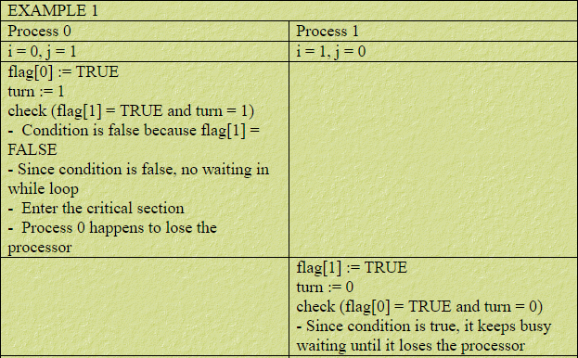
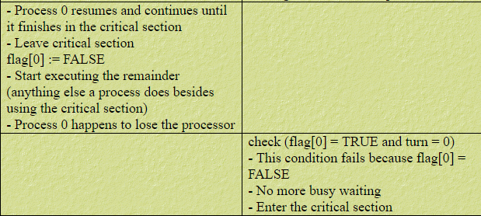
Peterson solution Dry Run1

Slide 24
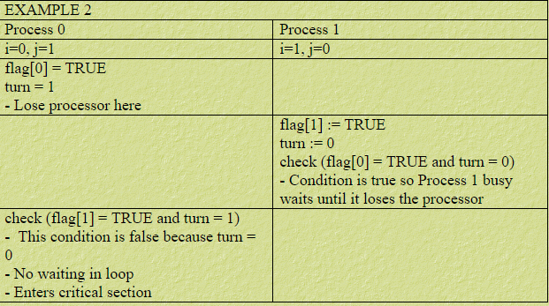
Peterson solution Dry Run2

Slide 25
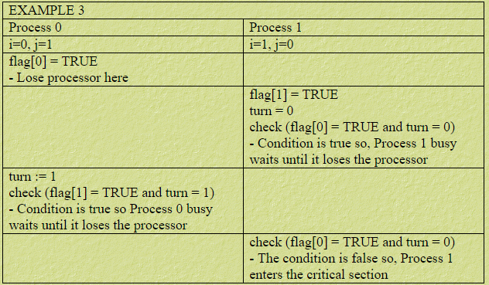
Peterson solution Dry Run3

